Slide 1
The Cairngorms National Park

Slide 2
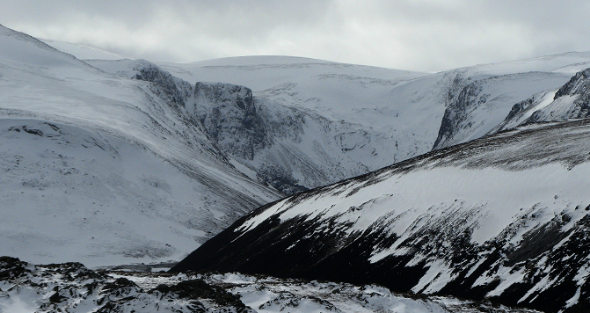
Why are the Cairngorms so special?
* It is an iconic landscape covering 4,528 square kilometres
* Has 5 of Scotland’s 6 highest mountains
* Contains the largest area of montane environment land over 600 metres in UK

Slide 3
Notes:
Iconic landscape – 4,528 sq km
5 of Scotland’s 6 highest mountains
Largest area of montane environment with land over 600metres in UK

Slide 4
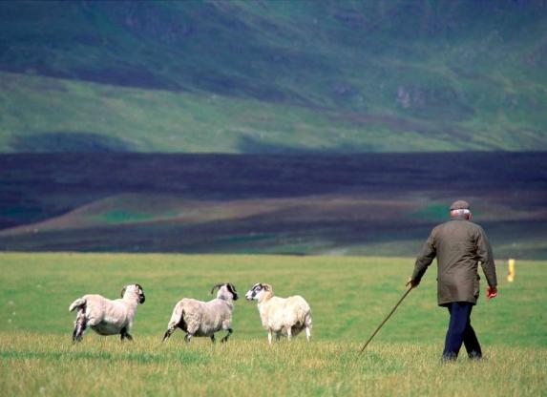
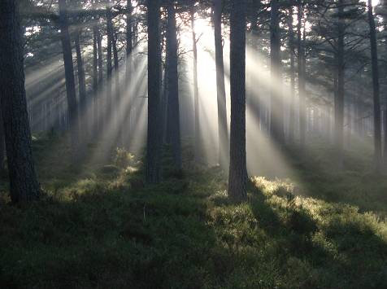
The Cairngorms a special place – a varied landscape influenced by people for generations whether for whisky, agriculture, sporting estates and tourism

Slide 5
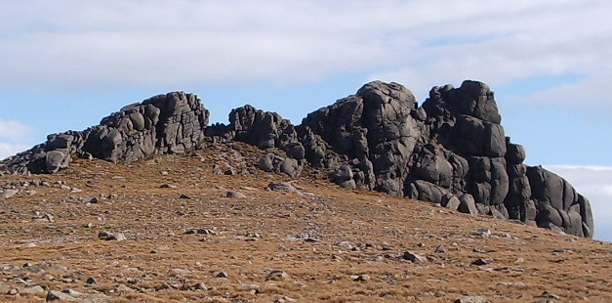
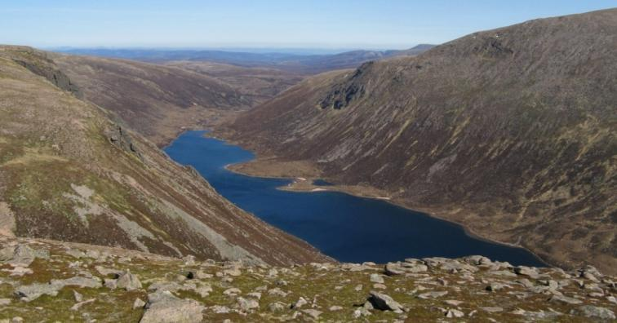
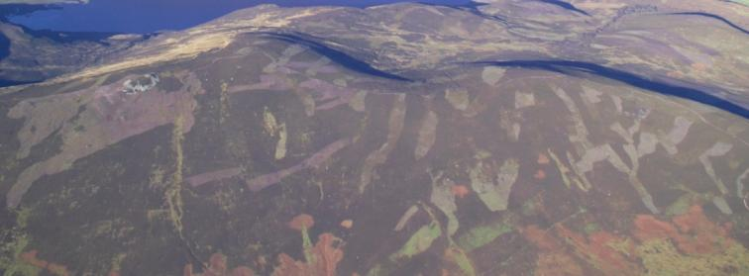
Notes:
Special place – varied landscape influenced by man for generations
Key industries – whisky, agri, sporting estates, tourism (most intensive)

Slide 6
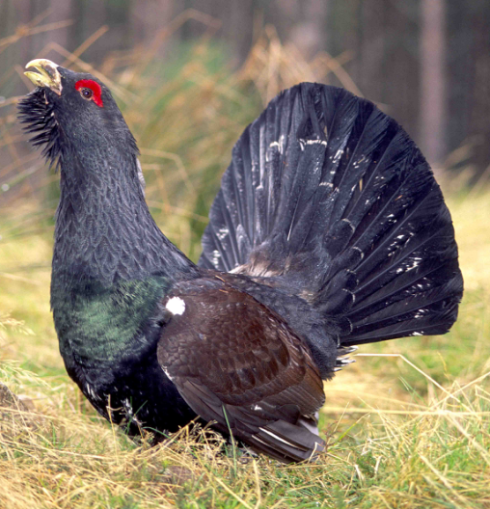
THE CAIRNGORMS
“a home for nature with 25% of UK’s threatened species, some of European importance like the CapercailIie, Dotterel and twin flower…”

Slide 7
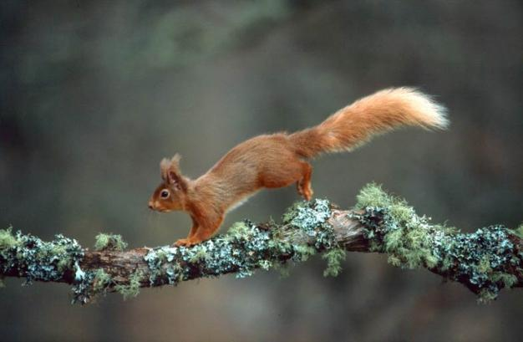
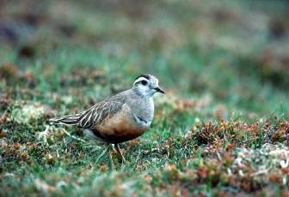
Notes:
25% of UK’s threatened species – some with European importance

Slide 8
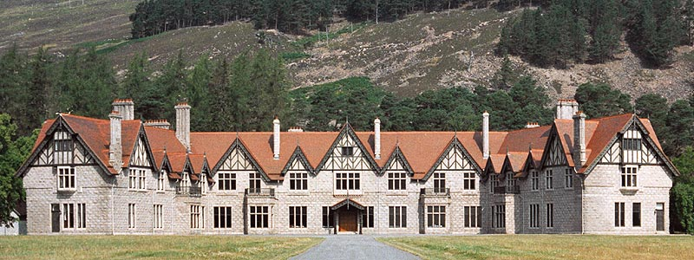
THE CAIRNGORMS
…”has a distinct culture and history…”

Slide 9
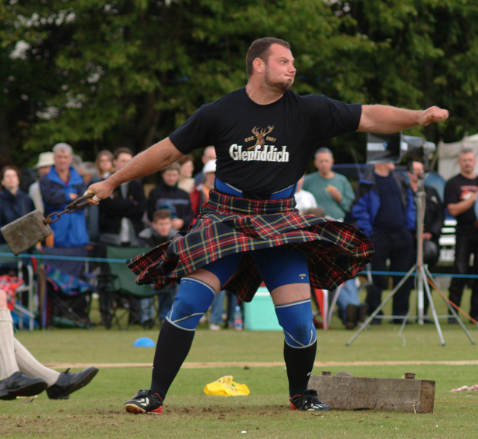
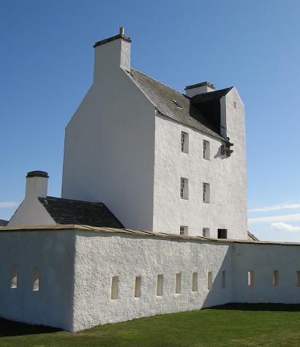
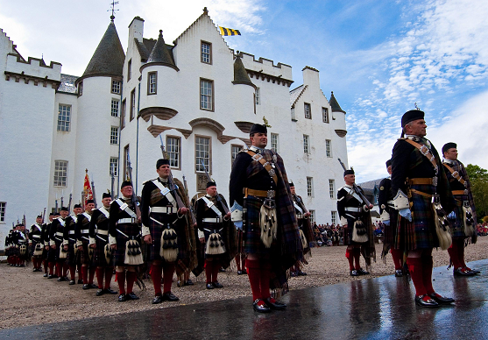
Notes:
Distinct and varied Cultural heritage

Slide 10
Help protect the Cairngorms National Park by treading lightly.

Slide 11
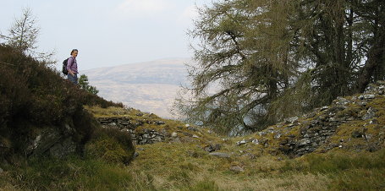
Setting the Scene
Everyone has a right of responsible access to Scotland’s countryside
This right extends to walking, cycling, horse riding and canoeing
The Scottish Outdoor Access Code provides guidance on what responsible access looks like

Slide 12
The five key things to remember when enjoying the Park

Slide 13
Planning ahead pays off:
Know the issues and concerns for the area that you’ll be visiting
Find out about the land management and the possible impact you may have on it
Consider giving something back to the area by contacting the land manager or local ranger to offer some help with a conservation task
Are there any rare species in the area that may be vulnerable to disturbance at certain times e.g. capercaillie during the breeding season
Encourage the group to sit down and write and agree their own code of conduct before they set off
Help groups to engender a sense of respect for the area they are visiting

Slide 14
Planning ahead continued…
Spread the impact and avoid peak times of the year or popular routes
Use local shops to support the economy
Reduce your carbon footprint by using public transport, car sharing or consider using bikes?
Park considerately and pay for parking as the money is often used for environmental work in the Cairngorms
How far afield do you really need to travel to achieve the objectives of your expedition?

Slide 15
Wild camping
Is one of the best ways to enjoy and appreciate the beauty of the open hills and countryside.
Increased numbers of campers means that we must all now take more care and responsibility than previously to minimise our environmental impact
We all appreciate the qualities of the wilderness experience in the hills including feelings of solitude, tranquillity, peacefulness and closeness to nature
Almost1200 DofE candidiates annually access the Cairngorms/Grampian area, as well as millions of other public users.
Be aware that your group members may also take groups to the same sites in future
We all agree that it is important to manage and maintain these qualities in our countryside for future generations to experience
.

Slide 16
Are you a responsible camper?
Avoid overcrowding by planning and researching your route and campsites. Consider the accumulative impact
Camp unobtrusively and keep groups small
Remember that noise travels from tents disturbing wildlife as well as humans
Be discreet. Camp well away from buildings, paths and tracks
Pitch tents late and take them down early
Enjoy the freedom of wild camping without leaving a trace of your passage

Slide 17
We want to avoid this!

Slide 18
Litter - pack it in and out!
Leave your camping spot tidier than you found it
Do a litter sweep before leaving the site. This could be done on hands and knees!
Collect up and take away other litter as well as your own, even the smallest amounts
Do not bury or hide litter under stones as it can harm wildlife
Take out all litter even if it is biodegradable such as banana skins and tea bags
Carry all scraps of food out as it attracts scavenging animals which prey on more sensitive nesting birds
The impact of plastic on the environment has been well documented
Don’t forget your tent pegs!

Slide 19
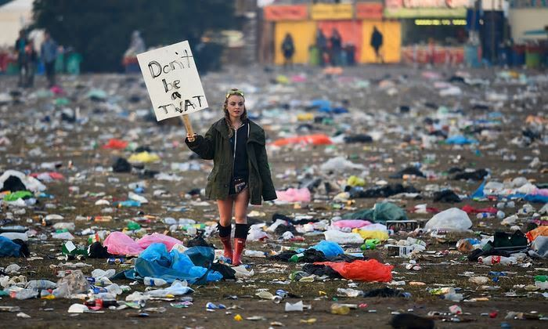
Try to avoid this!
Don’t litter

Slide 20
Toileting matters
Carry a trowel or a large communal spade to bury human waste
Find a spot at least 30 meters from water when going to the toilet
Bury human waste in a small hole, recommended 15 cm deep and not under boulders
When to carry out your waste:
Do not dig at all in sensitive areas such as the Cairngorm plateau
Do not dig cat holes on wet or boggy ground as the waste will not break down
Burying tampons and sanitary towels doesn't work as animals dig them up

Slide 21
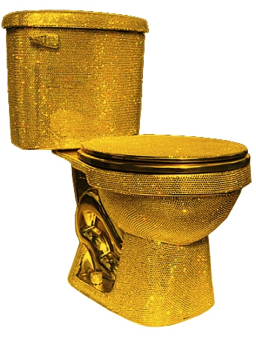
Toilets continued…
Consider the cumulative impact of human waste at well used sites
Always defecate downhill from your campsite and collect water from above
Never bury your excrement in snow
Dig through the snow to find the ground level first
Burn toilet paper in the hole. In dry weather consider carrying it out
And finally never miss the opportunity to use a proper toilet

Slide 22
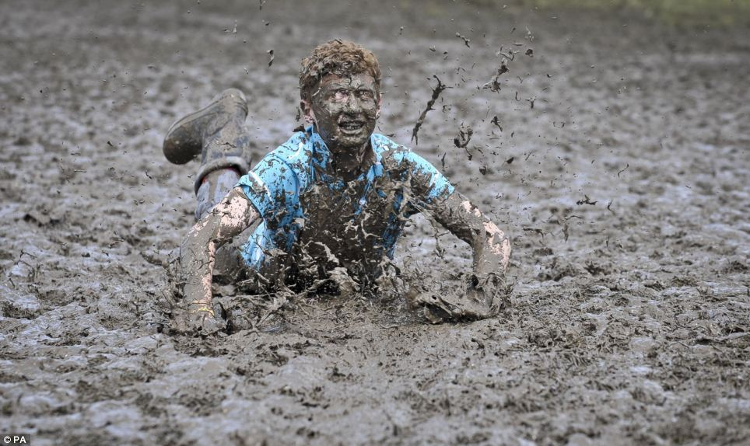
Camp hygiene
To wash yourself or your dishes carry water at least 30 meters away from burns or lochs
Use small amounts of biodegradable soap and scatter strained dishwater
Do not take wipes on your expedition!

Slide 23
Hill walking considerations
While our individual impact is minimal, the fact that so many of us use the mountains can cause problems
Spilt larger parties into smaller manageable groups
Paths have been constructed to protect mountains from the erosion that is caused by the sheer volume of visitors
Aim to use paths and tracks if available
Staying on paths can reduce your disturbance to deer and ground nesting birds during the breeding season
Do not cut corners or walk alongside paths

Slide 24
Hill walking continued…
Walk inside an erosion scar, rather than around it. Use gaiters if muddy
Walk in single file on narrow paths or erosion scars
Spread out in open country where there are no paths
When met by oncoming walkers stop and move to the side rather than walk on the edge of the path
Do not add to cairns
Do not climb over walls and fences. Use styles and gates where possible

Slide 25
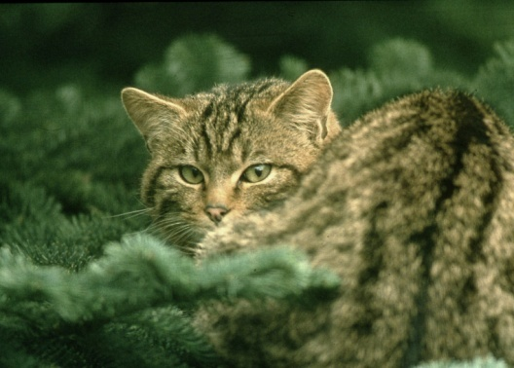
Respecting wildlife
Observe wildlife from a distance
If you find young animals give them a wide berth
Avoid nesting or feeding animals
Consider the cumulative impact that human disturbance has on wildlife
If you think that your activities are disturbing animals then change what you are doing
Let nature’s sound prevail. - keep noise levels to a minimum
Good campsites are found not made. Keep any alterations to a minimum
Do not dig drainage ditches, remove vegetation or move boulders
Watercourses and loch sides can be important sites for birds and mammals. Avoid the temptation to camp immediately beside them

Slide 26
Further Information
http://cairngorms.co.uk/park-authority/advice- guidelines/outdoor- access- advice
http://www.outdooraccess-Scotland.com
www.nts.org.uk/Property/Mar-Lodge-Estate/
adamstreetersmith@cairngorms.co.uk
http://www.glentanarcharitable trust.org/ gallery.htm
ranger@glentanartrust.org
http://www.rspb.org.uk

